Slide 1




Slide 2
VISION
A leading, dynamic and responsive consulting firm with vast experience and expertise in urban and rural development instrumental to organizational growth and national building for global competitiveness.

Slide 3
MISSION
Committed to provide high standard of various technical and management services, we aim to respond to client’s specific needs and requirements, both government and private entities, thus contributing to an improved change in the organization, the community, and
the country as a whole

Slide 4
COMPANY DESCRIPTION
UICI is one of the Philippines’ top multi-disciplinary consulting firms
Established in 1980; has 39 years of solid experience in providing consulting services at all levels of development programs.
The objective of UICI is to continue to succeed by providing sound engineering with a creative approach for the provision of a high quality, professional services on time and within budget.
The Management of UICI is in the hands of Directors, most of whom are the founders of the Firm
The members of the Board would act as Project Principals for every project and would maintain a close Client-Consultant liaison at all times.

Slide 5
ORGANIZATIONAL CHART
UICI BOARD OF DIRECTORS
PRESIDENT
Engr. Efren L. David
Exec. Secretary
EXEC. VICE- PRESIDENT
Engr. Christian G. Viray
Exec. Secretary
VP-BDG
Mr. Genaro C. Estrella
VP-ENGINEERING
Engr. Eleazar S. Regondola - OIC
VP-ADMIN
Ms. Elaila L. Andres
VP-FINANCE
Mr. Gerardo C. Danting-OIC
SECRETARY
SECRETARY
PROJ. COORDINATOR
PROJ. DIRECTOR
Engr. Eleazar S. Regondola
LOGISTICS
PROCUREMENT
HUMAN RESOURCE
SR. ACCOUNTANT
Mr. Gerardo C. Danting
SR. CASHIER
CONSULTANTS ON-CALL
ENGINEERING
CAD OPERATOR

Slide 6
RESOURCES
UICI owns a building for office and commercial purposes. The UICI Corporate Building is 4-storey, with more than 1,200 square meters floor area.
UICI utilizes the latest software and hardware for its engineering and architectural design and project management services.
UICI’s financial resources are deposited in Metropolitan Bank and Trust Co. (Metrobank), Planter’s Bank, Bank of the Philippine Island (BPI), and Land Bank of the Philippines

Slide 7
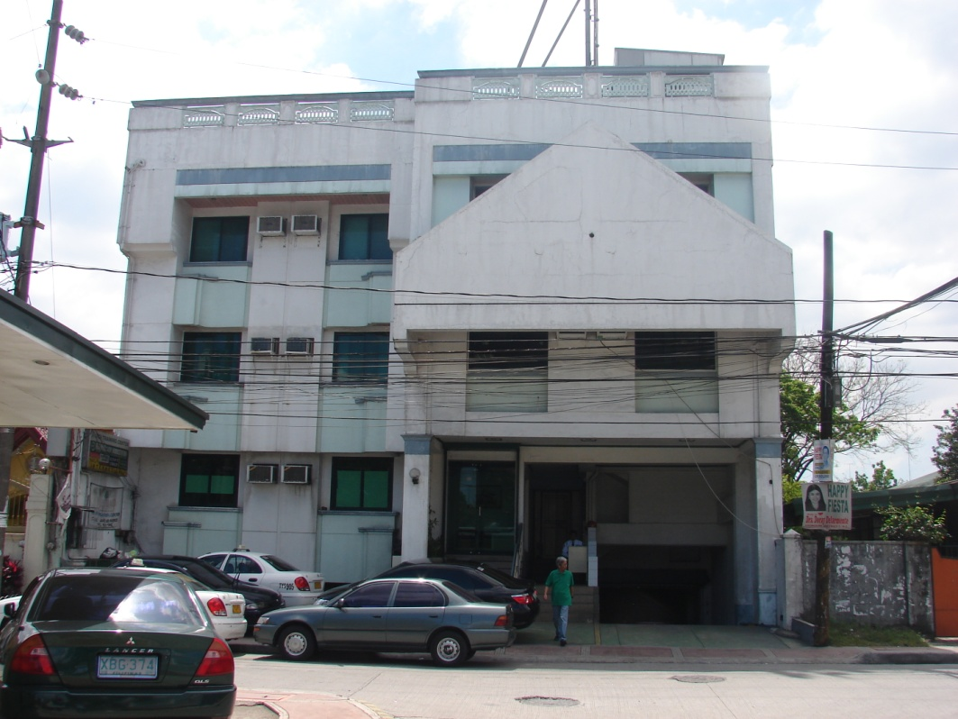
RESOURCES

Slide 8

SCOPE OF SERVICES
ENGINEERING | ARCHITECTURE
Auto-CAD Rendering Structural Engineering Soils and Foundation Engineering Civil/Electrical/Mechanical Engineering Sanitary/Environmental Engineering Water Resources Engineering Agri & Irrigation System Engineering Transport Engineering Geodetic Engineering Cost/Contracts & Specification Engineering Project and Construction Management | Building Design Master Planning Land Use Planning and Development Urban and Town Planning Industrial Estate Planning Ports Planning

Slide 9
SCOPE OF SERVICES
MANAGEMENT | PLANNING
General Management Consultation Management Review Project Feasibility Studies Financial Management Marketing Economics and Systems Information Technology Human Resources, Training and Development Agricultural and Rural Development Governance Small & Medium-Scale Enterprise Development | Recreation and Tourism Planning Social Planning and Community Consultation Environmental Engineering and Management Strategic Planning Landscape Architecture and Urban Design Geographic Information System Environmental Planning Development Planning

Slide 10
ACCREDITATION
Asian Development Bank (ADB)
NLEX Corporation
Australian Agency for International Development (AusAID)

Slide 11
MEMBERSHIP
Council of Engineering Consultants of the Philippines
Association of Consultant Civil Engineers of the Philippines
Society of Philippine Accredited Consultants, Inc.
Institute of Management Consultants for the Philippines
Confederation of Filipino Consulting Organizations

Slide 12
CLIENTS
NATIONAL GOVERNMENT AGENCY
Office of the President of the Philippines
Department of Land Reform
Department of Education
Department of Finance
Department of Environment and Natural Resources
Department of Health
Department of National Defense
Department of Public Works & Highways
Department of Social Welfare & Development
Department of Tourism
Department of Trade & Industry
Department of Transportation & Communications
GOVERNMENT OWNED & CONTROLLED CORPORATION
Clark Development Corporation
Local Water Utilities Administration
Subic Bay Metropolitan Authority
Bases Conversion and Development Authority
GOVERNMENT FINANCIAL INSTITUTION
Development Bank of the Philippines
Land Bank of the Philippines
LOCAL GOVERNMENT UNITS
Cities & Municipalities
Regional Development Councils
JUDICIARY
Supreme Court of the Philippines

Slide 13
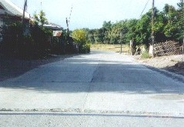
MAJOR UNDERTAKINGS
ROADS
6th ADB-Assisted Road Project, Road Improvement Component
Design and Construction Supervision of 6PY-1 & 2 Patnongon–Culasi–Nabas Road (113 km.long PCCP, const. of numerous bridges, RCBCs & instl’n. of RCPCs including protection works), Antique & Aklan, Philippines
Patnongon-Culasi Road (Portland Cement Concrete Pavement)

Slide 14
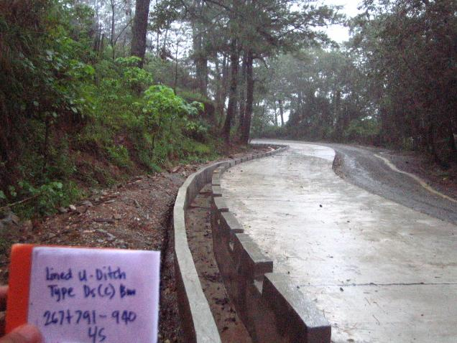
MAJOR UNDERTAKINGS
ROADS
Baguio-Aritao Road Improvement Project Engineering Design and Construction Supervision of CPs - 1 & 2 Baguio–Pangawan, Kayapa & Pangawan, Kayapa–Aritao Sections (66 & 30 km. long PCCP, Reconst. of Bridges, & drainage & slope protection structures), Baguio & Aritao, Philippines
JBIC Funded
Baguio-Aritao Road (PCCP with Concrete Lined Ditch)

Slide 15
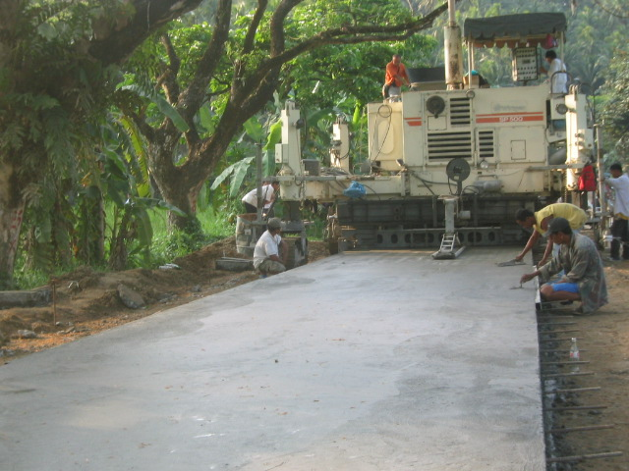
MAJOR UNDERTAKINGS
ROADS
Catarman–Calbayog via Lope de Vega & Iloilo East Coast-Capiz Roads Improvement Project,
Design and Construction Supervision of CPs – 1 & 2 (82.82 km. Road const. w/ PCCP, const. & rehab. of Bridges & const. of drainage including protection works), Samar & Iloilo, Philippines
JBIC Funded

Slide 16
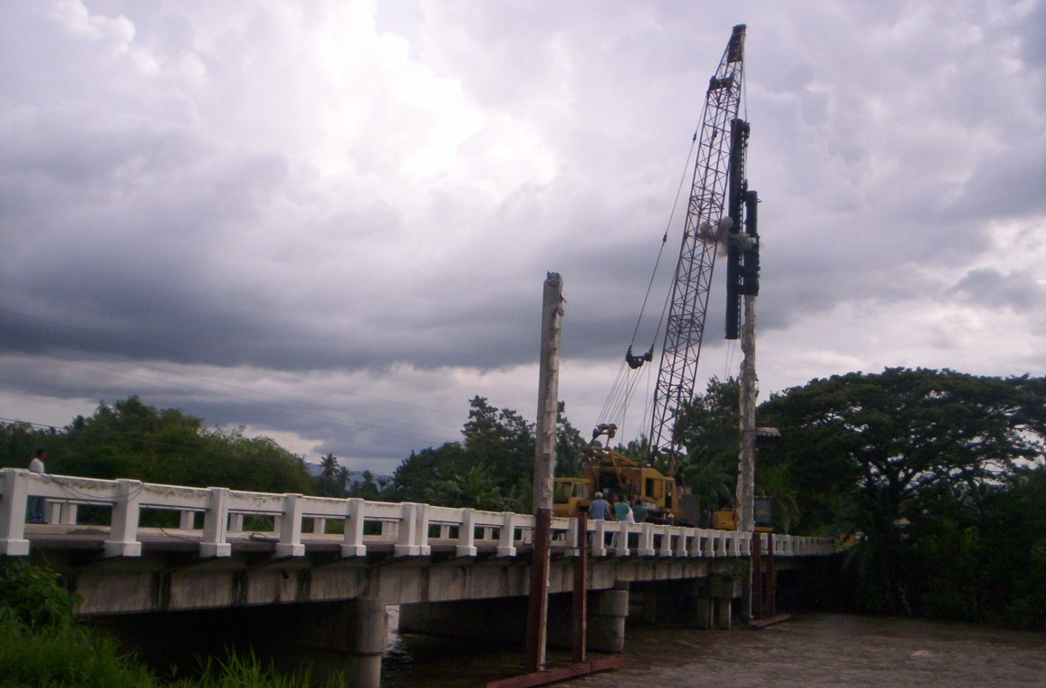
MAJOR UNDERTAKINGS
BRIDGES
6th ADB-Assisted Road Project, Bridge Component, Design and Construction Supervision of Contract Package P-NCR (replacement and reconstruction of three (3) bridges namely: Don Galo-La Huerta Bridge (75m-3span), Sevilla Bridge (60m-5span) & Tullahan Bridge (48m-4span)); Contract Package T-Zambales (two (2) replacement
bridges – Pamatawan Bridge – 53m & Lipay 6th ADB-Assisted Road Project, Bridge Component (Banga Bridge), Bridge – 106m); and Contract Package 4-Mindanao (retrofit of eleven (11) bridges and replacement of three (3) bridges). Philippines
6th ADB-Assisted Road Project, Bridge Component (Banga Bridge)

Slide 17
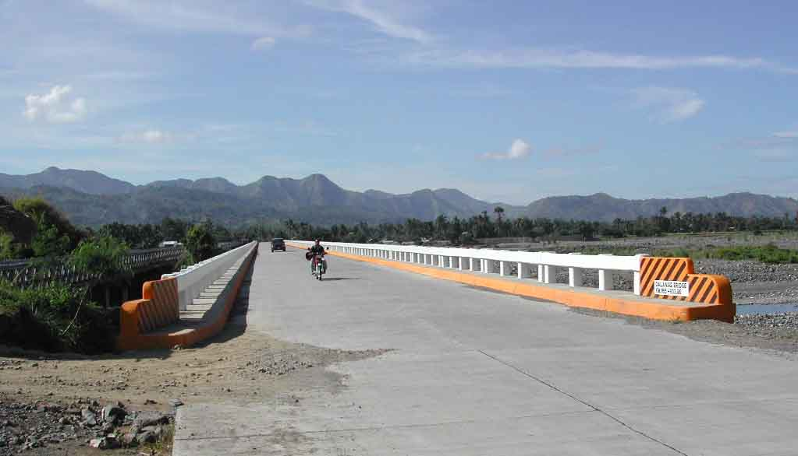
MAJOR UNDERTAKINGS
BRIDGES
6th ADB-Assisted Project
Design and Construction Supervision of Five (5) Bridges: Binangbang, Budyawis, Ipil, and Malbug II bridge in 6PY-1, Patnongon-Culasi Section & Aguila Bridge in 6PY-2, Culasi-Nabas Section, Antique & Aklan, Philippines
Patnongon-Culasi Road (Dalanas Bridge)

Slide 18
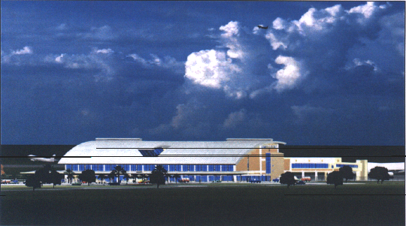
MAJOR UNDERTAKINGS
AIRPORT
New Bacolod (Silay) Airport

Slide 19
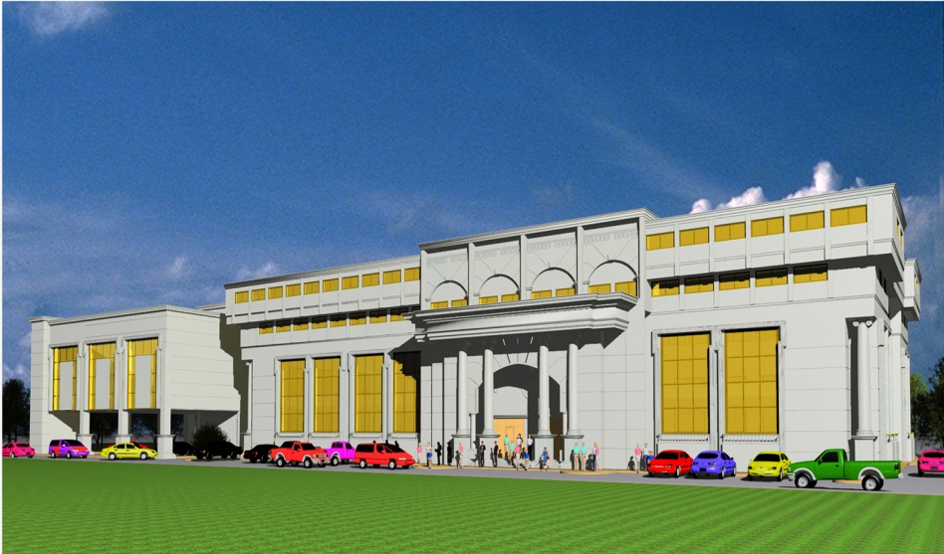
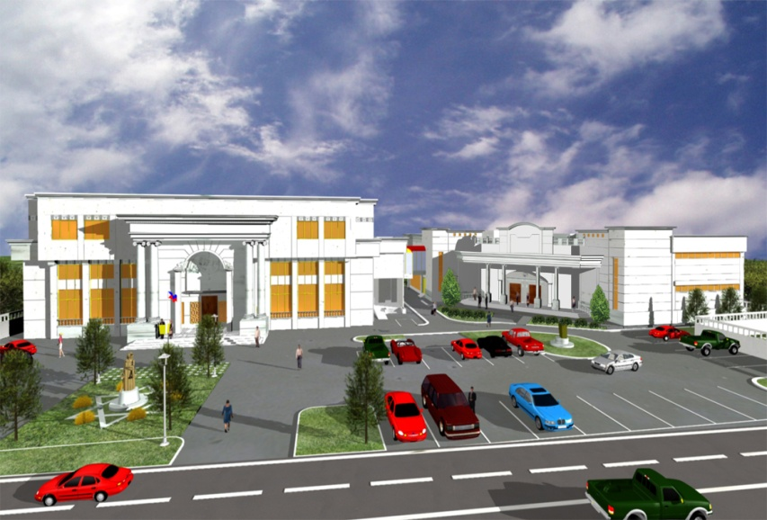
MAJOR UNDERTAKINGS
FEASIBILITY STUDIES
Feasibility Studies and Preliminary Design for the JRSP Pilot Model Courts:
Halls of Justice Pilot Sites in Lapu-lapu City and Bacolod City in the Visayas

Slide 20
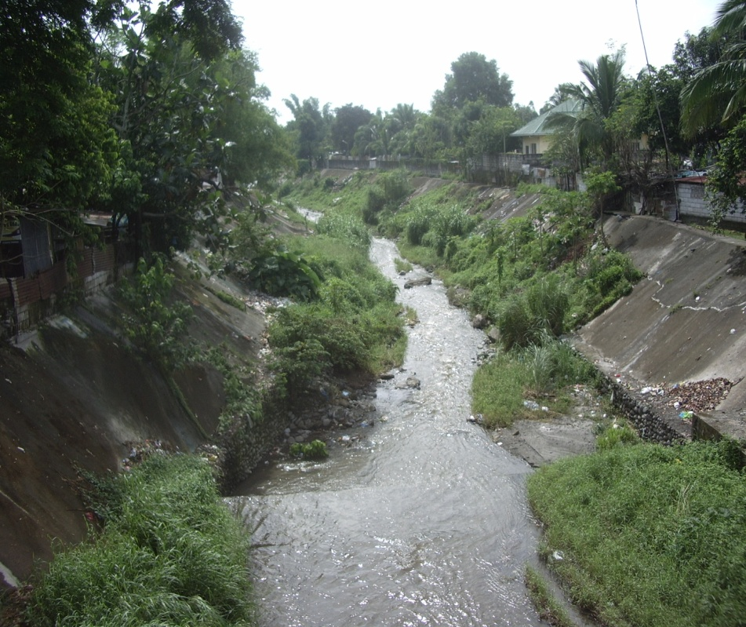
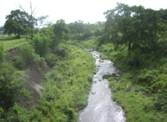
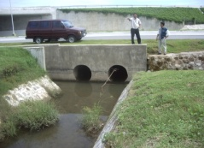
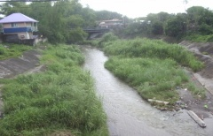
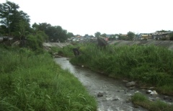
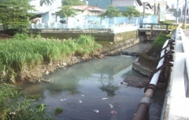
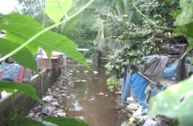
MAJOR UNDERTAKINGS
MASTER PLANNING
Comprehensive
Drainage Study for
Clark Freeport Zone

Slide 21
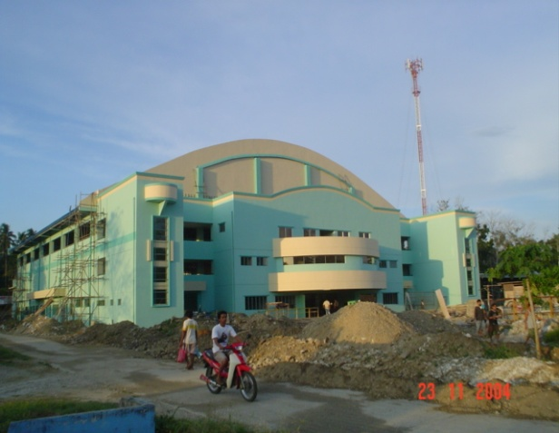
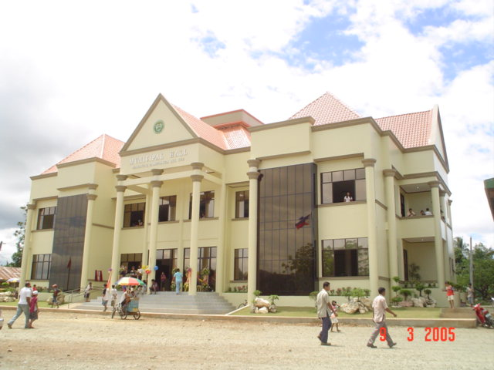
MAJOR UNDERTAKINGS
AREA DEVELOPMENT / PROJECT MANAGEMENT
Mindanao Basic Urban Services Sector Project (MBUSSP)

Slide 22
CURRENT PROJECTS
Feasibility Study for the Hydropower Component of Barotac Viejo Reservoir Irrigation Project
Bridge Construction Replacement Program (BCRP) I, Design and Build Bridges in Region II, Contract Package 1-B
Consultancy Services for the Detailed Engineering Design for the Horizontal Infrastructure Project of the Clark International Airport New Terminal Building Project (formerly Clark Airport Low Cost Terminal)
Independent Consultant for the NLEX-SLEX Connector Road
Independent Consultant for the Mactan-Cebu International Airport PPP Project

Slide 23
The End Thank you!

